Slide 1
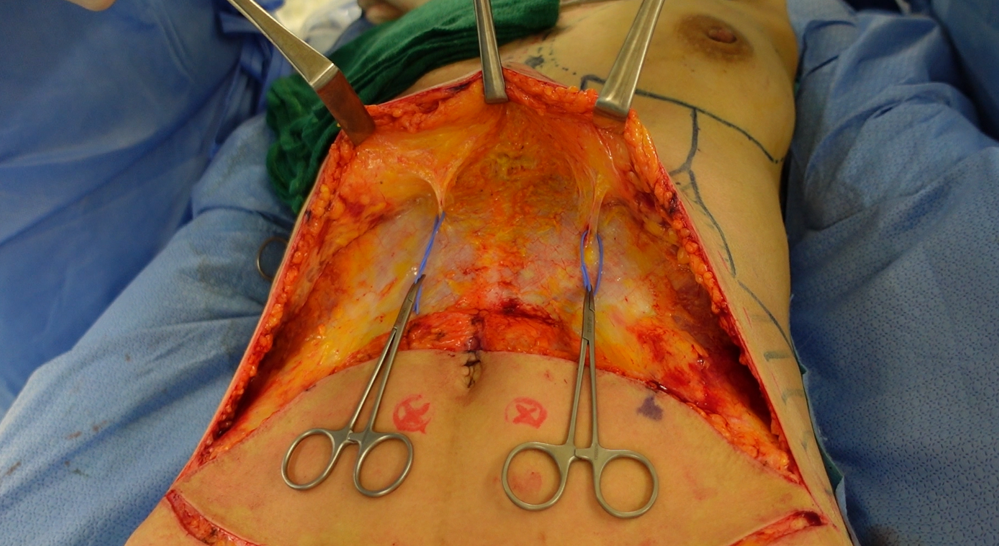
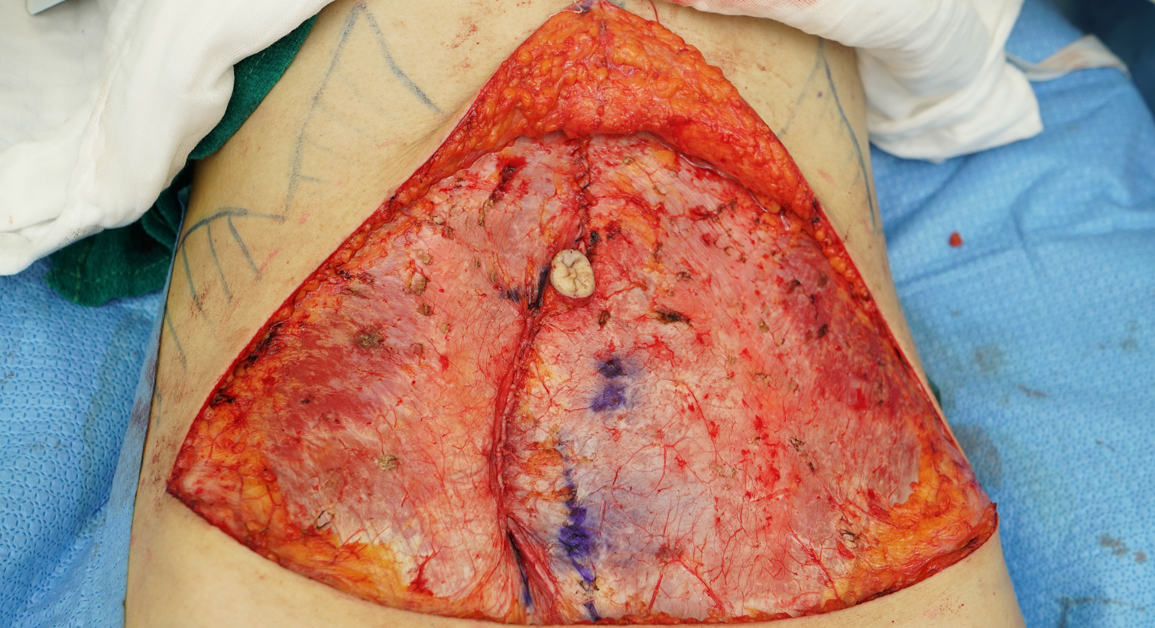
Repair of anterior fascia and linea alba
腹直筋前鞘と白線の修復
・ Preservation of the superior epigastric artery perforators
・ Repair of linea alba separation caused by
pregnancy and childbirth
上腹壁動脈穿通枝の温存
妊娠出産に伴って拡大した白線の修復

